Slide 1
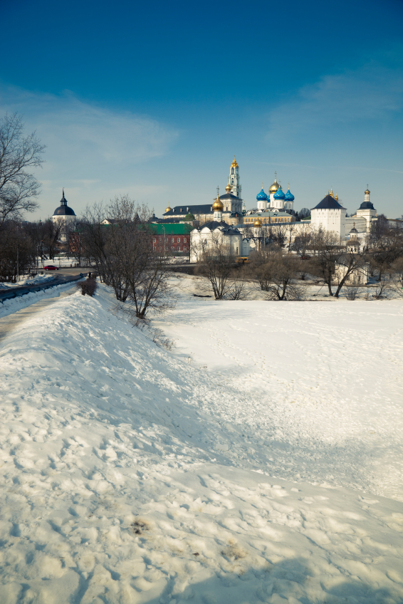
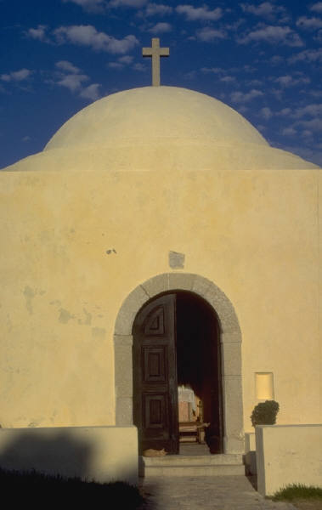
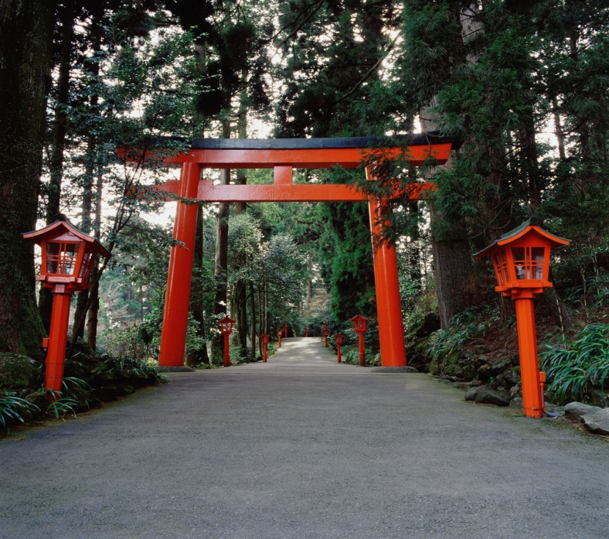

Preparing Your
Faith Community
to Respond
Is a disaster an opportunity to practice your faith?

Slide 2

There are steps you can take that can fulfill your faith commitment to yourself and your responsibility as a citizen.
Disaster Preparedness:
Individual & Family Preparedness
Preparing Your Faith Community
External Ministries

Slide 3
Individual and Family Preparedness
3 Important Steps:
Create an emergency plan for you and your family
Build a kit of emergency supplies to last you and your family 72 to 96 hours
Listen for information about what to do and where to go during an emergency event

Slide 4
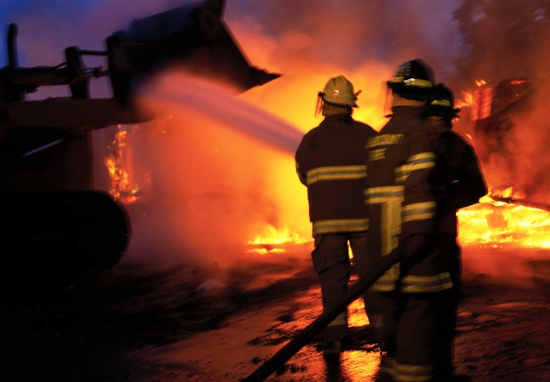
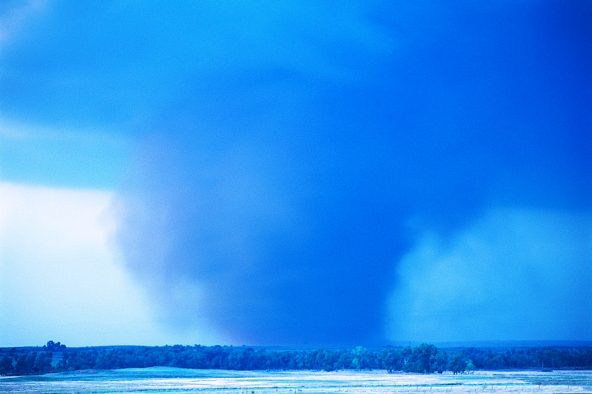
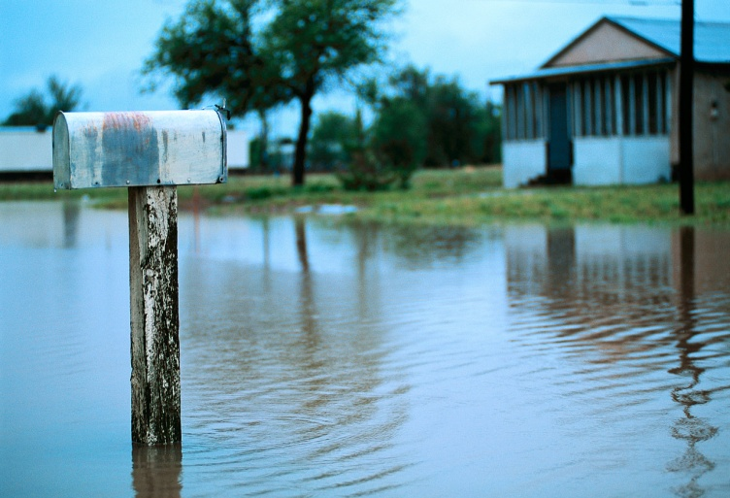
Preparing Your Faith Community
Which services must continue for your faith community to survive?
What can be set aside?
How would you accomplish critical functions?
Where do you get the needed resources?

Slide 5
Preparing Your Faith Community
The primary objective is to protect your faith community in the event that all or part of its operations and facilities are rendered unusable.
Develop and maintain capability to continue your operations.
External ministry, how to maintain that capability to be ready when called upon to help

Slide 6
Preparing Your Faith Community
People You Should Know
County / City Emergency Management Director
Law Enforcement
Fire / EMS
Local Hospitals / Nursing Homes
Red Cross / Salvation Army
Other Churches / Ministries In Area
Tap your own faith community for expertise

Slide 7
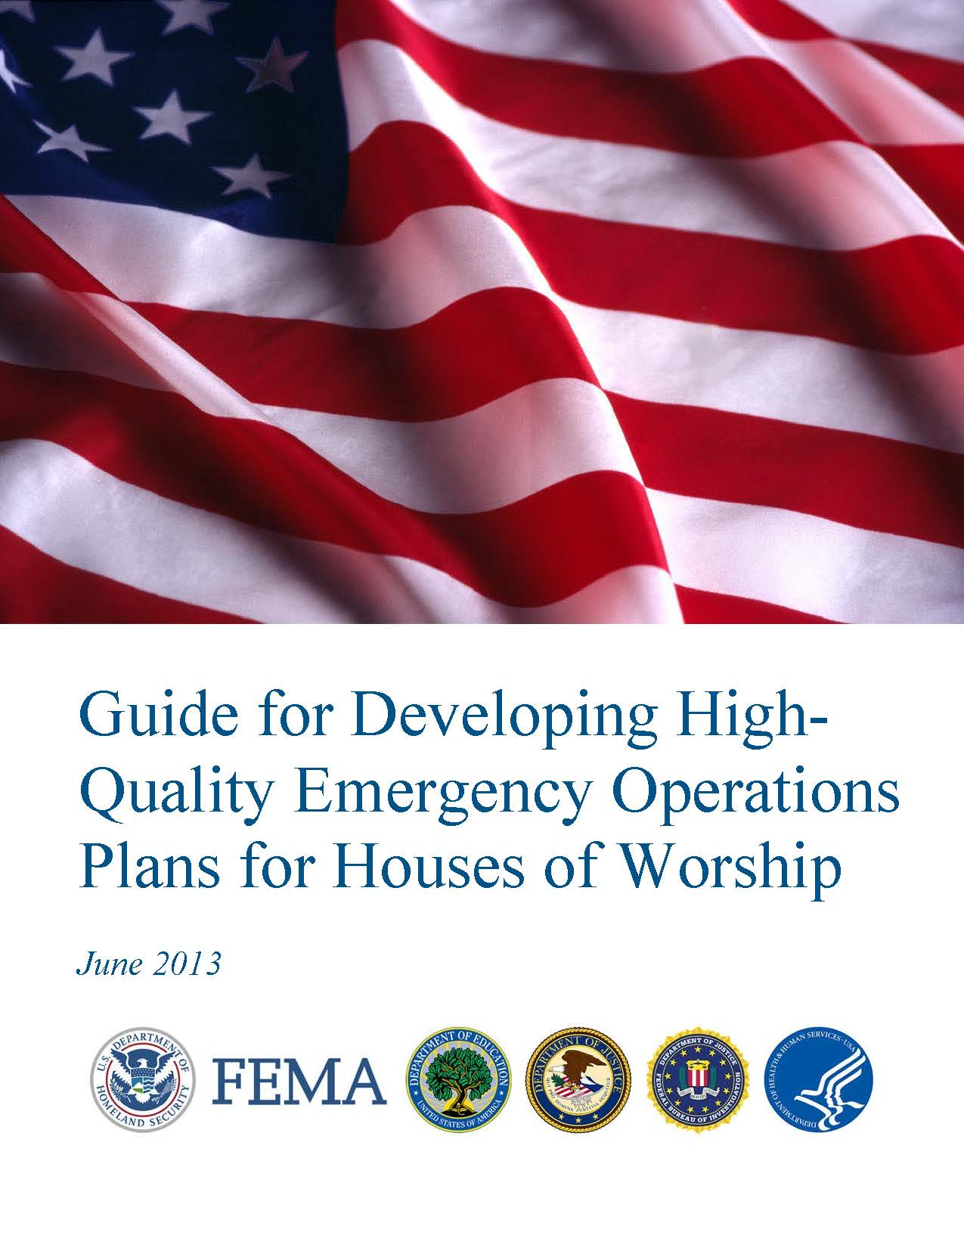

Slide 8
Mass Care – a High Profile External Ministry
What is Mass Care?
Sheltering
Feeding
Distribution of Emergency Supplies
Additional Opportunities
Chain Saw Gangs
Volunteer Reception Center
Multi Agency Resource Center

Slide 9
Mass Care – a High Profile External Ministry
Sheltering–
The temporary sheltering of disaster survivors and volunteers.
Does your FC have the facilities to shelter?
Does your FC have the volunteers to staff a shelter?
Must prepare a shelter plan
Shelter volunteers should take the Red Cross course on Shelter Management

Slide 10
Mass Care – a High Profile External Ministry
Mass Feeding –
Feeding large populations who have been affected by a disaster.
Does your FC have the facilities to do feeding of large numbers of people?
Volunteers should take the food handlers course offered by the LPHA.

Slide 11
Mass Care – a High Profile External Ministry
Distribution of Emergency Supplies –
The distribution of items such as water, food, blankets, (etc.) to survivors of a disaster.
A facility that can handle a large volume of traffic.
Storage for bulk supplies
Volunteers to staff this project 24 hours a day

Slide 12
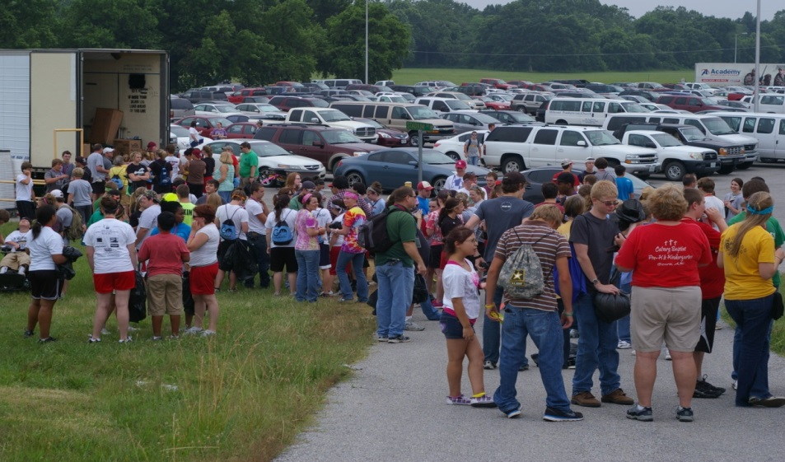
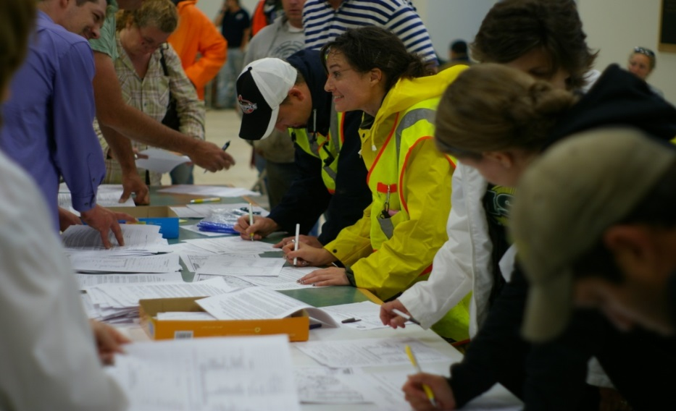
Mass Care – a High Profile External Ministry
Chain Saw Gangs
Volunteer Reception Center
Space for volunteers
Multi Agency Resource Center
Room for Agencies and Survivors

Slide 13
Resources
FEMA Training
http://www.fema.gov/prepared/train.shtm
MO SEMA
http://sema.dps.mo.gov
MO Dept of Health and Senior Services-Ready in 3
http://www.dhss.mo.gov/Ready_in_3/
Kansas Division of Emergency Management
http://www.ksready.gov
Functional Needs Support Services
http://www.disability.gov

Slide 15
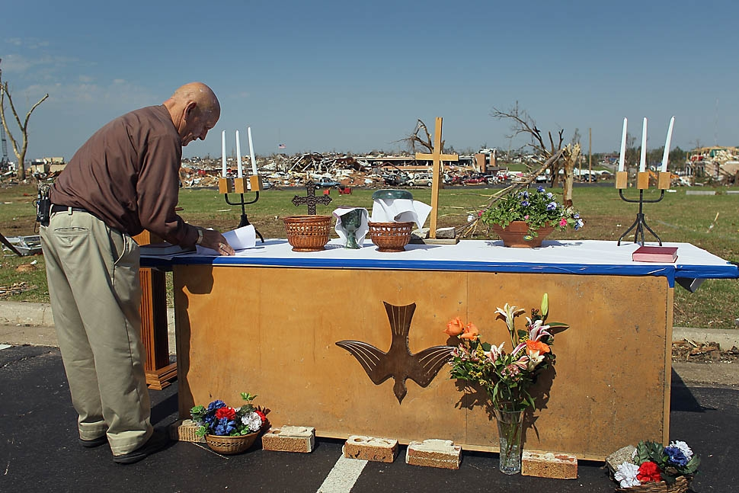
Are you Prepared?

Slide 16
Mike Pickerel
FEMA Mass Care Specialist
816-283-7955
mike.pickerel@fema.dhs.gov

