Slide 1

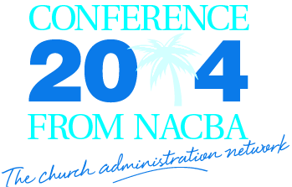

Creating Capital Reserves
Creating Capital Reserves
Glenn Wood
Keith Matthews
Tim Cool

Slide 2
Who are WE? Who are you?
Glenn Wood – Business Administrator, Seacoast Church
Keith Matthews - Executive Director, Jersey Baptist Church
Tim Cool – Chief Solutions Officer, Cool Solutions Group
Creating
Capital Reserves
Glenn Wood
Keith Matthews
Tim Cool

Slide 3
Why are capital reserves important?
Creating
Capital Reserves
Glenn Wood
Keith Matthews
Tim Cool

Slide 4
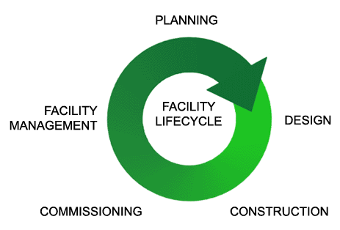
Creating
Capital Reserves
Glenn Wood
Keith Matthews
Tim Cool

Slide 5
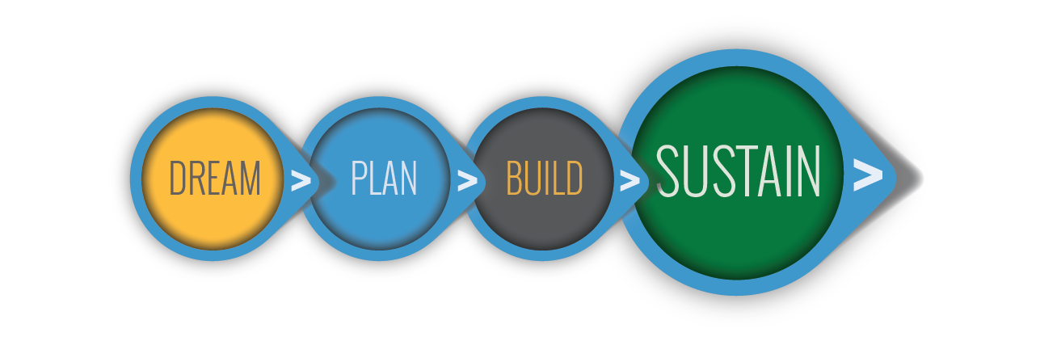
Creating
Capital Reserves
Glenn Wood
Keith Matthews
Tim Cool

Slide 6
The Real cost of facility ownership
Creating
Capital Reserves
Glenn Wood
Keith Matthews
Tim Cool

Slide 7
INITIAL COST: >30,000 SF Facility >$145/SF (building only) >7% design fees $4,654,500.00
Creating
Capital Reserves
Glenn Wood
Keith Matthews
Tim Cool

Slide 8
Debt: $3,000,000 15 year am. 6% interest Payoff in 7 yrs. $1,100,000.00
Creating
Capital Reserves
Glenn Wood
Keith Matthews
Tim Cool

Slide 9
Operations - $5.25-$7.50/SF* > Utilities - $1.00 - $1.50 > General Maintenance - $2.50 -3.50 > Janitorial - $1.75 - $2.50 * Does not include managerial staff, grounds or insurance
Creating
Capital Reserves
Glenn Wood
Keith Matthews
Tim Cool

Slide 10
Operations - $5.25-$7.50/SF Capital Reserves-$1-2.00/SF TOTAL: $6.25 - $9.50 ASSUMPTION: $7.00/SF $210,000.00 Annually
Creating
Capital Reserves
Glenn Wood
Keith Matthews
Tim Cool

Slide 11
Assume a 40 year life cycle at 1.5%* annual inflation
Creating
Capital Reserves
Glenn Wood
Keith Matthews
Tim Cool
* 1.5% maybe too low…just saying

Slide 12
Initial Cost = $ 4,654,500 Cost of Money = $ 1,100,000 Operations = $13,440,000 (that is $448/SF…OUCH)
Creating
Capital Reserves
Glenn Wood
Keith Matthews
Tim Cool

Slide 13
Total Cost of Ownership
Creating
Capital Reserves
$19,194,500.00
Glenn Wood
Keith Matthews
Tim Cool

Slide 14
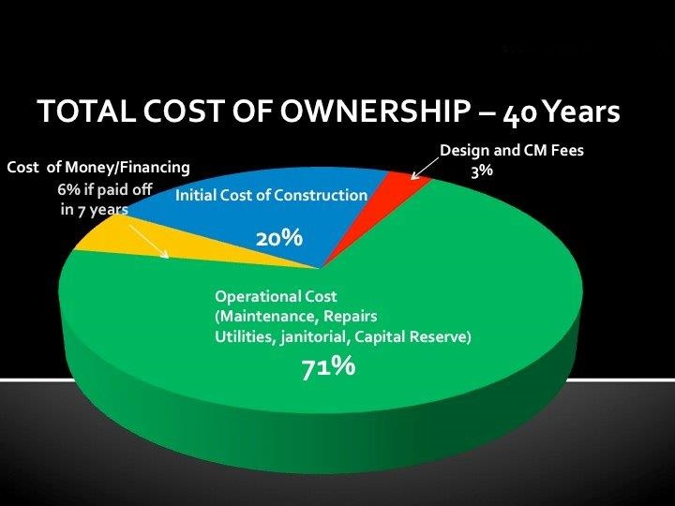
Creating
Capital Reserves
Glenn Wood
Keith Matthews
Tim Cool

Slide 15
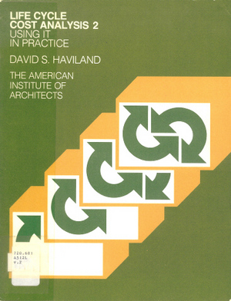

80% Operations
Creating
Capital Reserves
85% Operations
Glenn Wood
Keith Matthews
Tim Cool
71% Operations

Slide 16
The first Capital Reserves Account 2 Kings 12:4-15
Creating
Capital Reserves
Glenn Wood
Keith Matthews
Tim Cool

Slide 17
⁴ Joash said to the priests, “Collect all the money that is brought as sacred offerings to the temple of the Lord—the money collected in the census, the money received from personal vows and the money brought voluntarily to the temple.”
Creating
Capital Reserves
Glenn Wood
Keith Matthews
Tim Cool

Slide 18
⁵ Let every priest receive the money from one of the treasurers, then use it to repair whatever damage is found in the temple.”
Creating
Capital Reserves
Glenn Wood
Keith Matthews
Tim Cool

Slide 19
⁶ But by the twenty-third year of King Joash the priests still had not repaired the temple.
Creating
Capital Reserves
Glenn Wood
Keith Matthews
Tim Cool

Slide 20
⁷ Therefore King Joash summoned Jehoiada the priest and the other priests and asked them, “Why aren’t you repairing the damage done to the temple? Take no more money from your treasurers, but hand it over for repairing the temple.”
Creating
Capital Reserves
Glenn Wood
Keith Matthews
Tim Cool

Slide 21
⁸ The priests agreed that they would not collect any more money from the people and that they would not repair the temple themselves. PS: The hired people to do it!!!
Creating
Capital Reserves
Glenn Wood
Keith Matthews
Tim Cool

Slide 22
BTW… The Original Facility Managers Were Considered Holy Men Numbers 3:14-38 Levites were the first Facility Guys
Creating
Capital Reserves
Glenn Wood
Keith Matthews
Tim Cool

Slide 23
25 These two clans were responsible to care for the Tabernacle, including the sacred tent with its layers of coverings, the curtain at its entrance,26 the curtains of the courtyard that surrounded the Tabernacle and altar, the curtain at the courtyard entrance, the ropes, and all the equipment related to their use. (NLT)
Creating
Capital Reserves
Glenn Wood
Keith Matthews
Tim Cool

Slide 24
31 These four clans were responsible for the care of the Ark, the table, the lampstand, the altars, the various articles used in the sanctuary, the inner curtain, and all the equipment related to their use. 32 Eleazar, son of Aaron the priest, was the chief administrator over all the Levites, with special responsibility for the oversight of the sanctuary. (NLT)
Creating
Capital Reserves
Glenn Wood
Keith Matthews
Tim Cool

Slide 25
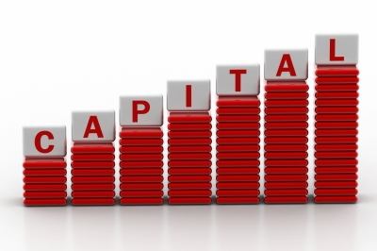
Reserves
Creating
Capital Reserves
Glenn Wood
Keith Matthews
Tim Cool

Slide 26
capital reserve (noun): an amount of money that a company or organization keeps in a special account for future needs Cambridge Business English Dictionary ©
Creating
Capital Reserves
Glenn Wood
Keith Matthews
Tim Cool

Slide 27
1. Money…Dollars, Green Backs, Currency 2. Special Account…Designated 3. Future…Down the road, not for now
Creating
Capital Reserves
Glenn Wood
Keith Matthews
Tim Cool

Slide 28
You are planning for the FUTURE, so you need to establish a SPECIAL ACCOUNT so that you have the money in the future.
Creating
Capital Reserves
Glenn Wood
Keith Matthews
Tim Cool

Slide 29
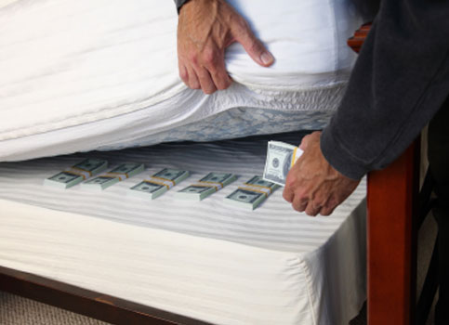
This is NOT a rainy day fund
Creating
Capital Reserves
Glenn Wood
Keith Matthews
Tim Cool

Slide 30
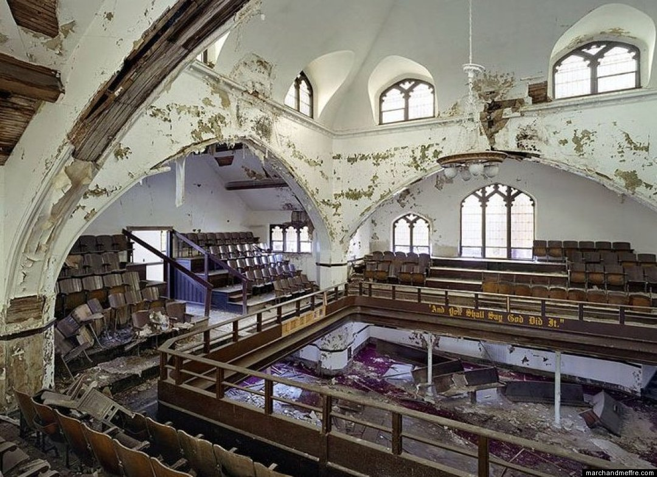
Fact: All Buildings deteriorate at an annual rate of 1-4%
Creating
Capital Reserves
Glenn Wood
Keith Matthews
Tim Cool

Slide 31
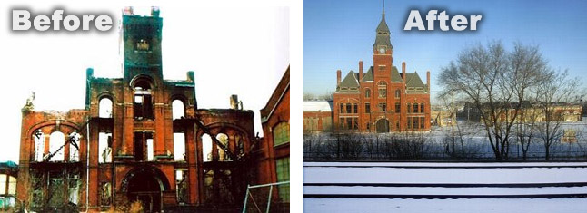
Fact: You must factor your deterioration rate on the Current Replacement Value (CRV)
Creating
Capital Reserves
Glenn Wood
Keith Matthews
Tim Cool

Slide 32
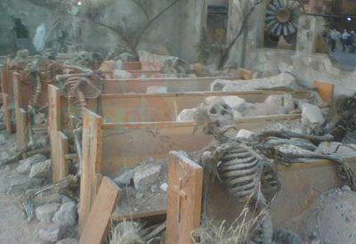
Fact: If you do not keep up with the natural rate of deterioration, the rate can more than double
Creating
Capital Reserves
Glenn Wood
Keith Matthews
Tim Cool

Slide 33
GLENN WOOD
Creating
Capital Reserves
Glenn Wood
Keith Matthews
Tim Cool

Slide 34
How much is enough?
Creating
Capital Reserves
Keith Matthews
Glenn Wood
Keith Matthews
Tim Cool

Slide 35
>How many of your churches have a
capital reserve fund?
>How old is your church building?
>Has anyone determined how much their
church’s capital reserves needs to be to
meet future expenditures?
Creating
Capital Reserves
Glenn Wood
Keith Matthews
Tim Cool

Slide 36
>Determine the threshold for a capital asset
>Make a list of assets that meet the
definition of a capital asset
>When was the asset put in service?
STEP 1
Creating
Capital Reserves
Glenn Wood
Keith Matthews
Tim Cool

Slide 37
STEP 1
>What is the life expectancy of the asset?
>What is the current replacement value
(CRV)?
Creating
Capital Reserves
Glenn Wood
Keith Matthews
Tim Cool

Slide 38
>Once you have collected all your data you can build your spreadsheet.
STEP 2
Creating
Capital Reserves
Glenn Wood
Keith Matthews
Tim Cool

Slide 39
Asset | Asset Name | Date Put in Service | Life Expectancy in Years |  |  | Cost
Number |  |  | Short | Moderate | Long
 |  | C | D | E | F | G
1.0 | HVAC: Unit 1 (50 Ton WAC Unit) | 1995 | 18 | 21 | 24 | $75,500
2.0 | HVAC: Unit 2 (WAC-North Of Choir) | 1995 | 15 | 18 | 21 | $6,500
3.0 | HVAC: Unit 3 (WAC-North Of Choir) | 1995 | 15 | 18 | 21 | $6,500
4.0 | HVAC: Unit 4 (WAC-North Of Choir) | 1995 | 15 | 18 | 21 | $6,500
5.0 | HVAC: Unit 5 (WAC-North Of Choir) | 1995 | 15 | 18 | 21 | $6,500
48.0 | ROOF: Chapel (8,600 Sq. Ft.) | 1987 | 25 | 28 | 31 | $19,350
49.0 | ROOF: 83 Bldg & Game Rm (8,600 Sq. Ft.) | 2009 | 20 | 25 | 30 | $19,350
54.0 | WAC: Main Roof: Standing Seam (Metal) | 1996 | 25 | 30 | 35 | $45,000
55.0 | WAC: West Shed Roof (9,300 Sq. Ft.) | 2008 | 10 | 15 | 25 | $13,320
56.0 | WAC: East Shed Roof (4,700 Sq. Ft.) | 2008 | 10 | 15 | 15 | $6,737
59.0 | Main Lobby Roof A - (4,500 Sq. Ft.) | 2009 | 25 | 30 | 35 | $12,375
60.0 | Main Lobby Roof B - (2,000 Sq. Ft.) | 1996 | 15 | 20 | 25 | $4,000
61.0 | Rubber Roofs (Entrances & Connectors) | 2000 | 25 | 30 | 35 | $5,000
62.0 | Youth Barn - Bi-rib Roof (4,000 Sq. Ft.) | 2003 | 20 | 25 | 30 | $8,000
63.0 | Mission House Roof | 2003 | 10 | 15 | 20 | $8,000
66.0 | North House Roof (3,900 Sq. Ft.) | 2009 | 25 | 30 | 35 | $11,200
68.1 | Asphalt - Chapel Parking Lot - ReSurface | 1986 | 20 | 25 | 30 | $31,366
68.2 | Asphalt - Chapel Parking Lot - Seal Coat | 2011 | 2 | 3 | 4 | $3,000
70.0 | Asphalt - West Parking Lot | 1997 | 20 | 25 | 30 | $162,512
Creating
Capital Reserves
Glenn Wood
Keith Matthews
Tim Cool

Slide 40
>Once you have collected all your data you can build your spreadsheet. >Additional Information needed: Current Capital Reserve Balance Annual Capital Reserve Budget >Now the spreadsheet will prepare a Summary Document (Excel)
STEP 2
Creating
Capital Reserves
Glenn Wood
Keith Matthews
Tim Cool

Slide 41
STEP 3
>Review your Cumulative Replacements Costs
against your Cumulative Reserves
>Review the Documents with your Church Leadership
(Staff, Finance Committee, Board, etc.)
>Determine if any additional funds need to be moved
into your Capital Reserves
Creating
Capital Reserves
Glenn Wood
Keith Matthews
Tim Cool

Slide 42
Creating
Capital Reserves
Glenn Wood
Keith Matthews
Tim Cool

Slide 43
Creating
Capital Reserves
Glenn Wood
Keith Matthews
Tim Cool

Slide 44
STEP 4
>Annually review with Leadership the Assets that are scheduled for Replacement
>Annually update the spreadsheet with assets that
have been replaced or new assets that have been added
>Annually review your ratio of Cumulative Reserves to Cumulative Replacement Costs
Creating
Capital Reserves
Glenn Wood
Keith Matthews
Tim Cool

Slide 45
How to project component costs
Creating
Capital Reserves
Glenn Wood
Keith Matthews
Tim Cool

Slide 46
Q & A
Creating
Capital Reserves
Glenn Wood
Keith Matthews
Tim Cool

Slide 47

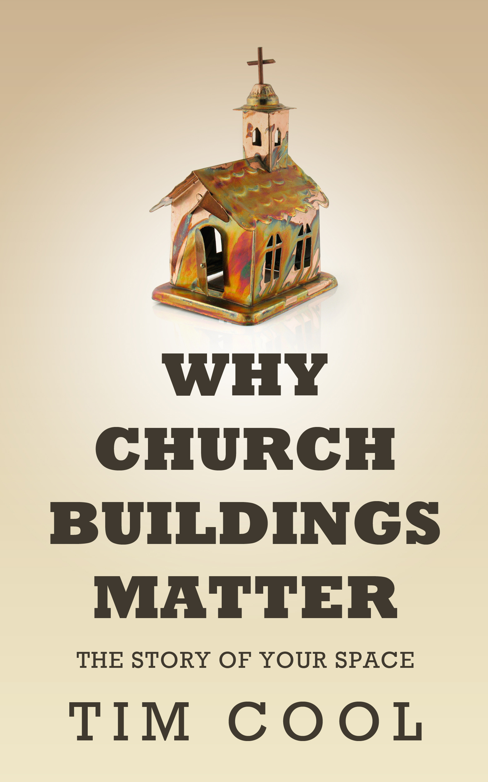
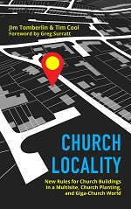

Slide 48
Creating
Capital Reserves
Glenn Wood
Keith Matthews
Tim Cool

Slide 49
Creating
Capital Reserves
Glenn Wood
Keith Matthews
Tim Cool

